Slide 1
Math 8 Honours lesson 4 Order of Operations
© Copyright all rights reserved to Homework depot: www.BCMath.ca

Slide 2
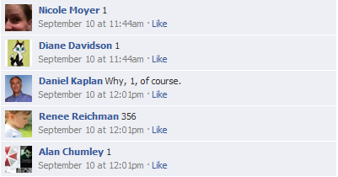

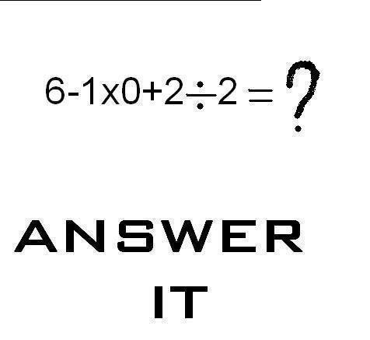
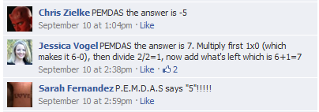
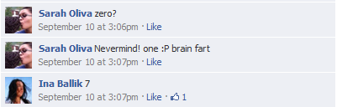
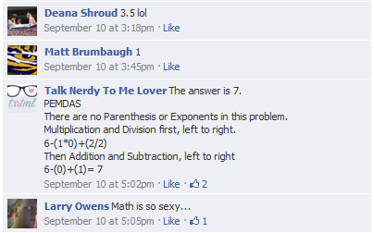
© Copyright all rights reserved to Homework depot: www.BCMath.ca

Slide 3
What is the first answer that you have in mind?
8 is wrong!!
© Copyright all rights reserved to Homework depot: www.BCMath.ca

Slide 4
Math Trick:
When an expression has only “adding” or “subtracting” you can rearrange the numbers based on whether if you are adding or subtracting it
When looking at this equation, there are 5 numbers. Each number is either added or subtracted
The 12 is “ADDED” b/c it is the first number and it is positive
The 10 is “ADDED” b/c it has a plus sign in front of it
The 8 and 5 are both “SUBTRACTEd” b/c it has a minus sign in front
The last number 4 is “ADDED” b/c it has a plus sign in front of it
So what we do is rearrange our equation like this:

Slide 5
Practice using the Math Trick to evaluate the following:
Which numbers are added?
18 and 12
Which numbers are Subtracted?
10, 5, and 7
Here’s another trick, combine all the numbers that you are adding first. Then combine all the numbers that you are subtracting next. Then subtract the two numbers:
These two numbers are added. They combine to 30
These three numbers are subtracted. They combine to 22

Slide 6
Ex: Evaluate each of the expression on the left and match it with the correct answer on the right:

Slide 7
Order of Operations RULES:
Adding, Subtracting, Multiplying, Dividing are the basic operations in mathematics
When an expression has more than one of these operation together, we need to process them in proper order
RULE #1: When adding or subtracting, either operation can be done first (Rule: Always go from “Left” to “Right”)
RULE #2: Likewise, when multiplying or dividing, either operation can be done first, always go from “Left” to “Right”
© Copyright all rights reserved to Homework depot: www.BCMath.ca

Slide 8
RULE 1&2 (Combined): When adding, subtracting, multiplying, and dividing are all in one expressions, we must multiply or divide first. Adding or subtracting will be done afterwards
In this equation, we have “multiplication” and “division”. So we perform these operations first!!
After all the Multiplying/Division are done, we now perform the addition and subtraction
© Copyright all rights reserved to Homework depot: www.BCMath.ca

Slide 9
Ex: For each of the equations below, indicate which operation is to be completed first:
a) Add 12 and 17 first
c) Subtract 10 from 3
b) Multiply 17 and 3 first
d) Divide 10 by 2
a) Subtract 99 from 1
c) Multiply 3 and 5
b) Multiply 51 and 10 first
d) Divide 10 by 2

Slide 10
RULE #3: When you have an equation with multiplication and division only, use the TOP/BOTTOM method to simplify your equation
A term with a MULTIPLICATION to the LEFT will be on TOP
A term with a DIVISION on the LEFT will be on the BOTTOM
General: convert the expression into a fraction so it’s easier to simplify!
The first term “a” on the left is always on TOP
The next term “b” has a multiplication to it’s left → TOP
“d” term has a multiplication to it’s left, so TOP!
What about “f” and “g” ?
The 3rd term “c” has a division to it’s left → BOTTOM
What about the rest? “h”, “j”, and “k”?
What about “e”?
BOTTOM!

Slide 11
Practice: Evaluate
Since there are only multiplication and division operations, covert this all into a fraction
NOTE: Which ones you simplify first DOESN”T MATTER! As long as you simplify one of each term from TOP and BOTTOM!
Now we simplify by reducing any common factors that both the TOP and BOTTOM have!

Slide 12
Ex: Evaluate each of the expression on the left and match it with the correct answer on the right:

Slide 13
Ex: Given the following expression, which one is equivalent?

Slide 14
Rule 4 : Exponents are performed before Multiplication/Division
Note: 4b: When simplifying exponents, make sure to recognize whether if the base is “positive” or “negative”!!!
Note: any base to the power of zero is equal to ONE

Slide 15
When evaluating exponents, make sure to know what your base is
Indicate the base and then evaluate the following:

Slide 16
Q: Given three integers “a”, “b”, and “c” such that ${−a}^{b}=c$, where “$c“$ is a positive integer, then which of the statement(s) below are true?
a) Given that “c” is a positive integer, then “a” must be a negative value
b) Given that “c” is a positive integer, then “a” must be a positive value
c) “b” must be an ODD number
d) “b” can be either an EVEN or ODD number
e) “b” must be an EVEN number

Slide 17
Given each expression and the process of how it’s simplified, indicate which step the error is at:
This should be –12
Exponent before multiplying
Should be 4 x 32
The first error is in step 2. This should be +1
Copyright All Rights Reserved Homework Depot at www.BCMath.ca

Slide 18
Rule 5 : Brackets (parenthesis) should always be performed before any other operations!
Note: 5b “Inside brackets” should always be performed before “outside brackets”!

Slide 19
Q: Evaluate the following:
It doesn’t matter what’s inside this bracket. Since it’s to the power of zero, the whole thing become 1

Slide 20
Evaluate the following:

Slide 21
Q: What is the maximum value that can be obtained when “Brackets” are added to the expression below?

Slide 22
Evaluate the following by factoring:

Slide 23
Challenge: Insert the proper operations (+ – ÷ ×) to make the statement true:
© Copyright all rights reserved to Homework depot: www.BCMath.ca

Slide 24
Numbers from 1 to 121 are placed in a square grid such that every row, every diagonal, and every column will have an identical sum. Write an expression to represent the sum. Calculate it.

